Slide 1
Module 5
CRUD Operations
MySQL

Slide 2
Topics Covered:
INSERT
SELECT
WHERE
AND / OR
LIKE, IN, BETWEEN
ORDER BY
LIMIT / OFFSET
UPDATE
DELETE

Slide 3
Learning Objective
By the end of this session trainees will be able to:
Insert data into tables
Retrieve data using queries
Filter data using conditions
Sort and limit results
Update existing records
Delete records safely

Slide 4
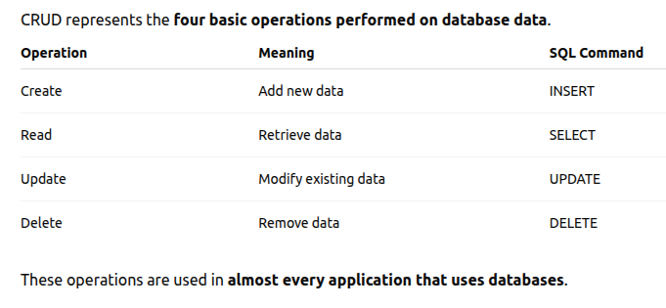
What is CRUD?

Slide 5
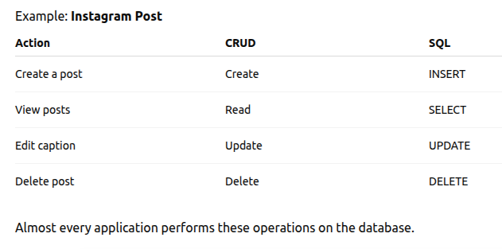
CRUD in Real World Applications

Slide 6
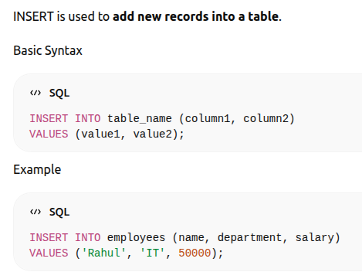
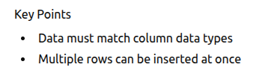
INSERT (Create Data)

Slide 7
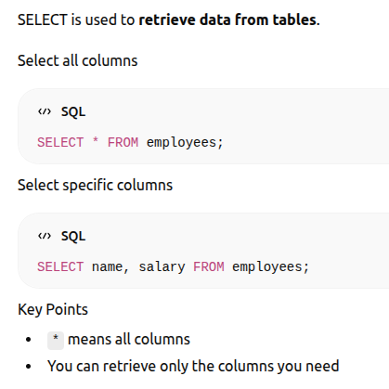
SELECT (Read Data)

Slide 8
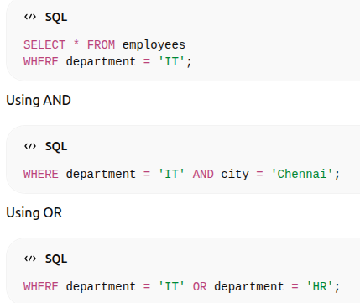
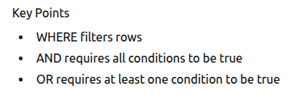
WHERE, AND, OR (Filtering Data)
The WHERE clause filters records based on conditions.

Slide 9
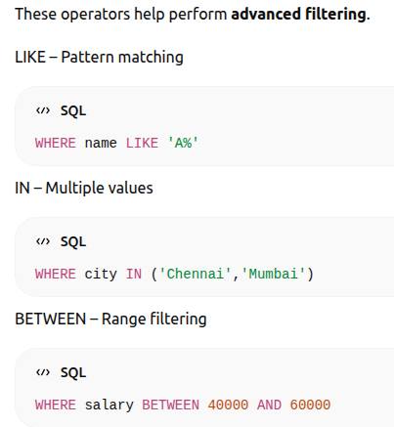
LIKE, IN, BETWEEN

Slide 10
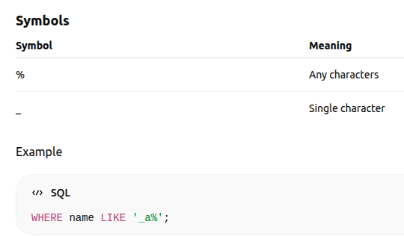
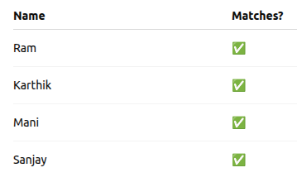
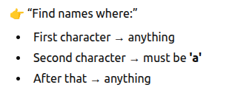

Slide 11
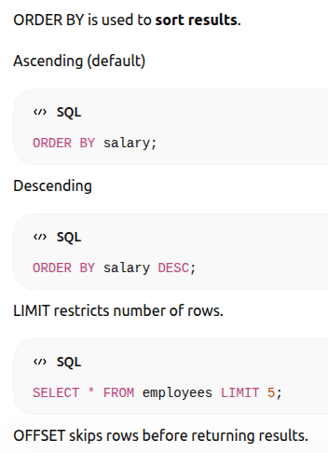
ORDER BY, LIMIT, OFFSET

Slide 12
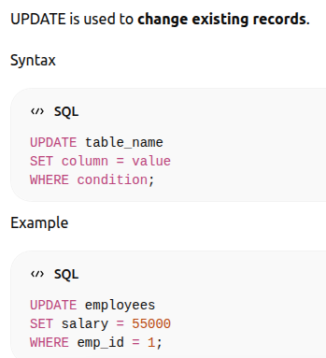

UPDATE (Modify Data)

Slide 13
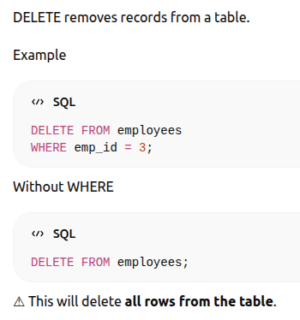
DELETE (Remove Data)

Slide 14
Summary
In this module we learned:
INSERT – Add records
SELECT – Retrieve records
WHERE – Filter records
LIKE / IN / BETWEEN – Advanced filtering
ORDER BY – Sorting
LIMIT / OFFSET – Pagination
UPDATE – Modify records
DELETE – Remove records
These operations form the foundation of SQL database interaction.

Slide 15
Practical session

Slide 16
MCQ Test

